Slide 1

ML-based Investment Analytical Tool
Meeting the needs of a changed Investment Clientele
Thong Bui, Sarah Kelley, Natarajan Shankar,
Zhongqiao Jin
Notes:
Shankar

Slide 2

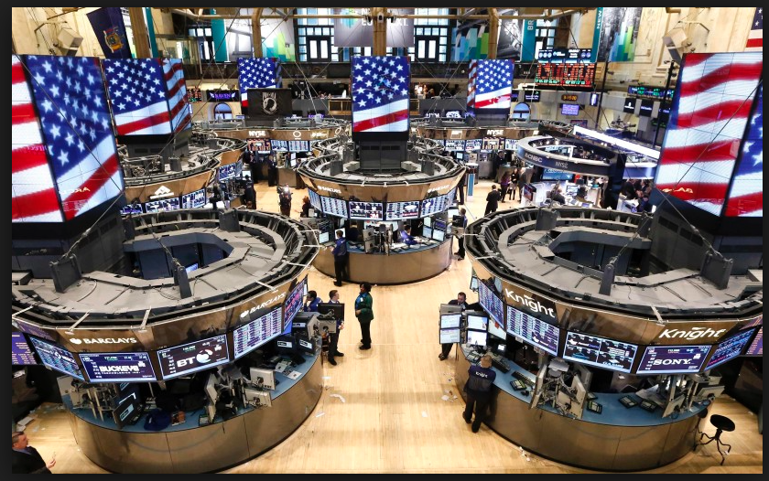
New Markets, Money Management, Data Science
New investment segment has been recognized, with huge potential
Millennials have invested in lower numbers - the largest potential segment
Millennials’ investment behavior different from that of prior generations
Robin Hood: Raised $176M, recently $100 Million at a $1.3B valuation
To support the new market, financial Industry disruption is underway
Zero-fee trades
No storefront offices, research reports, analytical tools
The new market is this project’s business driver
We offer a financial application that complements this new market
Why us?
Data forms the basis of investment decisions
Quantitative and Natural
But is voluminous and is in raw form
Needs tools and expertise, for insight
Leading to the birth of:
“Investment Analytical Tool”: pick the best stocks from S&P500 given preferences of long-term period and risk
Notes:
Shankar
Articulation of a lack of trust in standard institutions
Demonstrate marked gravitation towards technology
Seek humble fee structure, socially responsible approaches
Prepared to make decisions, assume risk
Data forms the basis of investment decisions
Multiple forces move markets and decisions, all characterized with data:
Quantitative
Fundamentals: PE Ratio, Revenue Growth
Economic Data: Inflation, Unemployment, Monetary
Behavioral: Psychology, Social Sciences
Textual: News, Whispers, Politics
Data is available for consumption but is voluminous and in raw form
Needs tools and expertise to leverage, for insight
Apps that augment the new business model have relevance
Intelligence extraction from multiple forms of data
Complex models but complexity hidden from the user
Provide a simple tool
Leading to the birth of:
“Investment Analytical Tool”

Slide 3
Approaches
Product Work Flow
Approaches:
We are providing a web-based solution to recommend individual stocks for the investors. The solution is leveraging both time series/static numeric data as well as NLP data to predict the future stock price and recommend it to the user based on their risk aversion
Highlights:
Enhanced input feature coverage
News sentiment feature inputs
LSTM-based predictive model
Cross validated results
Risk exposure caveat
Interactive UI allow user to select Risk aversion
Source
Company Fundamental Data
Stock Price Data
Company News Data
Sentiment
Score
Algorithm
LSTM Predictive Model
Recommendation
Stock recommendation based on user’s request
Notes:
Zhongqiao
We will dive into details in the following slides

Slide 4
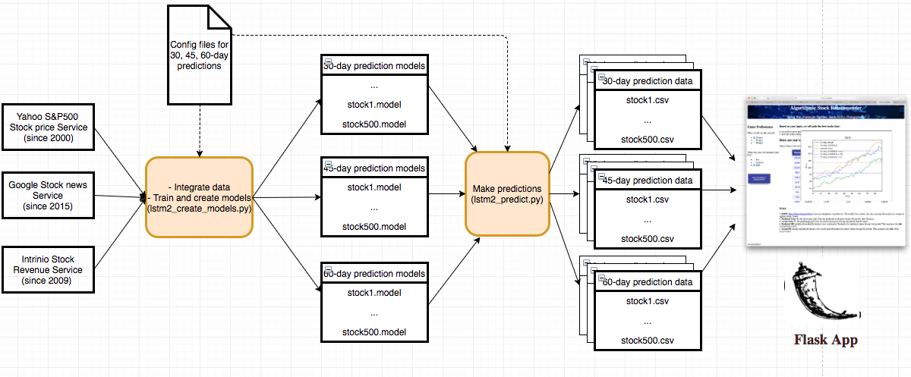
Detailed System Architecture
Notes:
Thong:
Here is the more detailed layout of our system architecture.
In this project, we choose to have 3 forecast types which are 30-day, 45-day and 60-day predictions
Starting from the left hand-side, you can see that we have a configuration-driven python process that integrates the 3 datasets from the 3 datasources.
It will then train and create the models for each of the forecast types.
2) Then, we have a 2nd configuration-driven python process that uses the models to make predictions on stock price
and generate statistics of the predictions measured against the actual prices.
3) These generated data is then queried by our Flask WebApp when user submits their selection of prediction types and level of risk comfort.

Slide 5
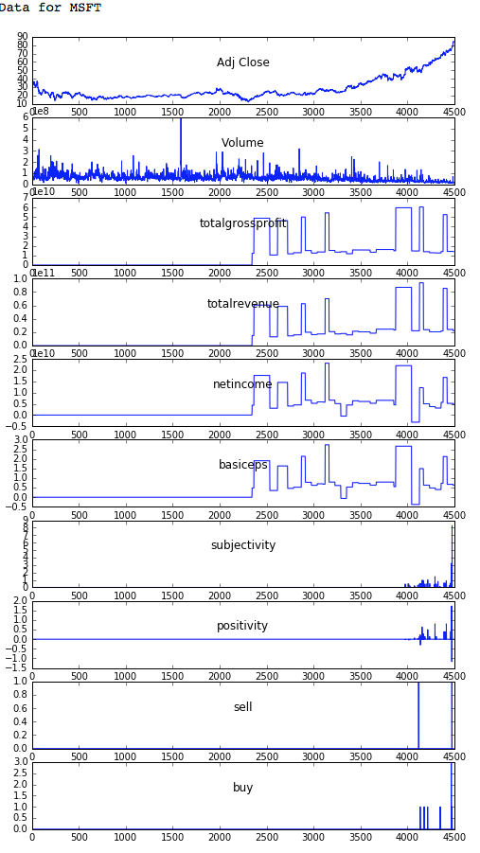
Data Analysis
Data Analysis:
Stock price data from 2000: Adj Close, Volume
Revenue data from 2009:
Use totalgrossprofit, totalrevenue, netincome, basiceps
Other features (operatingrevenue) are mostly 0s so we decided to drop them
3. News data starts from 2015:
Sentiment analysis to generate subjectivity, positivity
Generate buy, sell.
Data quality concerns with free data services
We decided to use the latest start date 2015.
Miss the downturn (crash in 2008)
Notes:
Thong -
And This is our data analysis on the 3 datasets:
The 1st one is stock price data starting from 2000 with features such as Adjusted Close, Volume
The 2nd one is revenue data which only has data starting from 2009 due to limitation of the free service we are using:
On this dataset, we extracted these features: totalgrossprofit, totalrevenue, netincome, basic eps
Other features (operatingrevenue) are mostly 0s so we decide to drop them
3. The 3rd one is news data which only has data starting from 2015 due to the similar limitation of the free service we are using
On this dataset, we perform sentiment analysis to generate subjectivity & positivity
We also extract these 2 features: buy, sell from the news
When merging the 3 datasets for training and testing, we decided to use the latest start date of 2015.
We are aware that this means that we are missing the data of the crash of 2008.
But we believe that in the future, when we pay for better data service, we will have better data and improve the predictions

Slide 6
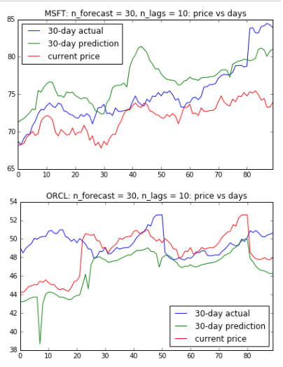
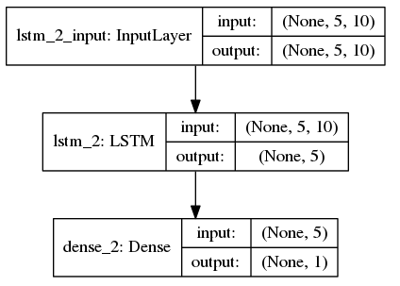
Models using time-series and LSTM
For each stock:
Create time-series dataset and label data for the future prices of 30, 45, 60 days
Train data: before the last 90 days. Test data: last 90 days
LSTM: useful and successful when dealing with a time series.
Long term dependencies in the network is done by gating mechanisms
Very good at holding long term memories
Minimize overfitting:
cross-validation against test data
early stopping (see details)
Models & Predictions
Notes:
Thong -
For modeling, we use the combination of time-series and LSTM
For each stock, we use the merged dataset to create time-series and label data for each forecast type
We then split it into train data which has data before the last 90 days and test data of the last 90 days
We also choose LSTM which is the recurrent networks that is useful and successful when dealing with a time series because
Long term dependencies in the network is done by gating mechanisms
Which is why it’s very good at holding long-term memories for time-series data
To minimize overfitting, we also perform cross-validation against test data so that we can do early-stopping

Slide 7
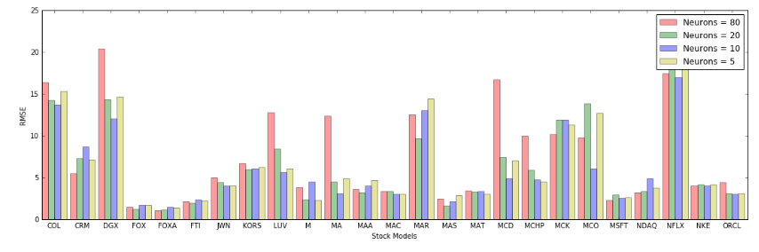
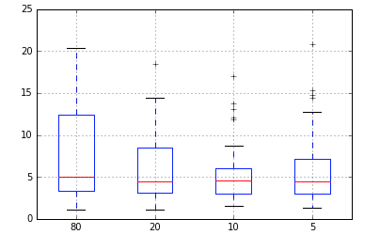
Models & Predictions (cont’d)
Parameter Tuning
We pick some parameters to tune for optimal RMSE and use them in config file for modeling
Ex: The optimal number of neurons for models to predict 30-day stock prices can be different from 45 or 60-day models (see the end of this notebook for more details)
Notes:
Thong -
We also tune some parameters to get the best/lowest Root Mean Squared Error (RSME) when measuring the predicted values against actual values.
Here is an example of how we tune number of neurons in LSTM by collecting RMSE data for each setting
and pick the one which yields the lowest and smallest range,
In this case, the best choice is number of neurons = 10.
Next, Zhongqiao will share with us more about Results and Evaluation

Slide 8
Results & Evaluation Criteria
Results:
The solution provides recommendation with a list of 10 stocks out of S&P 500 pool to users based on a combination of predicted return and the accuracy of the prediction. The solution also considered risk aversion and the expected return period.
Evaluation:
Used RMSE (root-mean-square error) to measure the accuracy of prediction. RMSE is a frequently used measure of the differences between values predicted by a model or an estimator and the values actually observed.
Leveraged SD (standard deviation) to measure the volatility of stocks during this period - how much the prediction price is changed during this period
Low risk: predicted SD < 33.33% quantile
Medium risk: predicted SD is between [33.33%, 66.66%]
High risk: predicted SD > 66.66%
Used S&P 500 index as the benchmark to measure the historical prediction efficiency.
Predicted Return
Recommend
Not Recommend
RMSE
Notes:
Zhongqiao
To avoid misleading investors
Simplify the process of picking the best stocks from a large pool of S&P500 stocks
Provided multiple options for different investor
Meanings of RMSE and Standard Deviation (SD) during this period (last 90 days)
RMSE measures accuracy of prediction
The smaller the number, the more accurate the prediction measured against actual values
SD measures the risk of this stock during this period - how much the prediction price is changed during this period
Low risk: predicted SD < 33.33% quantile
Medium risk: predicted SD is between [33.33%, 66.66%]
High risk: predicted SD > 66.66%
Pick the top stocks: a combination of average predicted gains and RMSE
Leveraged S&P 500 index average return as a benchmark of the comparison

Slide 9
User Interface Architecture
Interactive application to allow users to input risk and timeframe preferences
Flask served over a gunicorn webserver
connection to Python-based backend model
Dynamic HTML pages
Notes:
Sarah

Slide 10
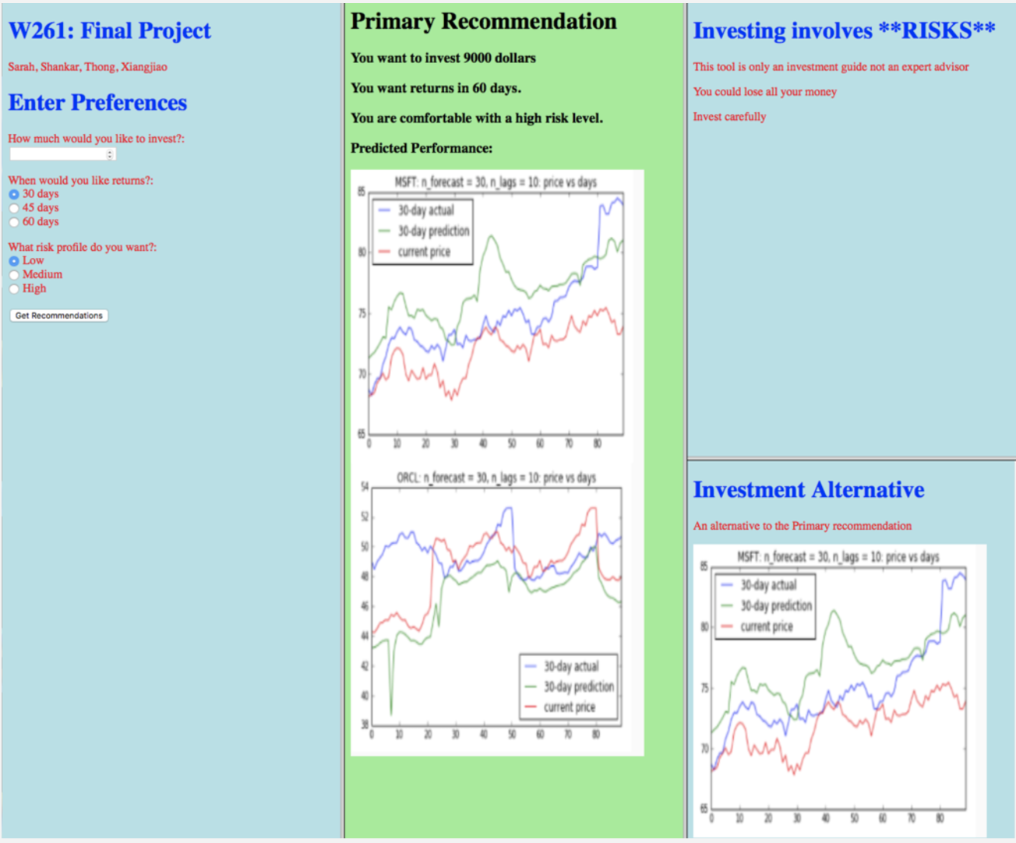
Original User Interface Design
Notes:
Sarah-

Slide 11
User Testing and Feedback
User testing with 10 millennials
Demographics:
21-36; all college educated, 6 women 4 men
None in the financial industry or DS
Core feedback:
Our interface is messy and doesn’t look professional -- “honestly it looks a little like a project from a HTML 101 class”
Don’t understand how the model works or why they should trust it
Found the graph extremely confusing
Mixed feedback on level of detail: got both people wanting more detail and feeling like there was too much data
Notes:
Sarah

Slide 12
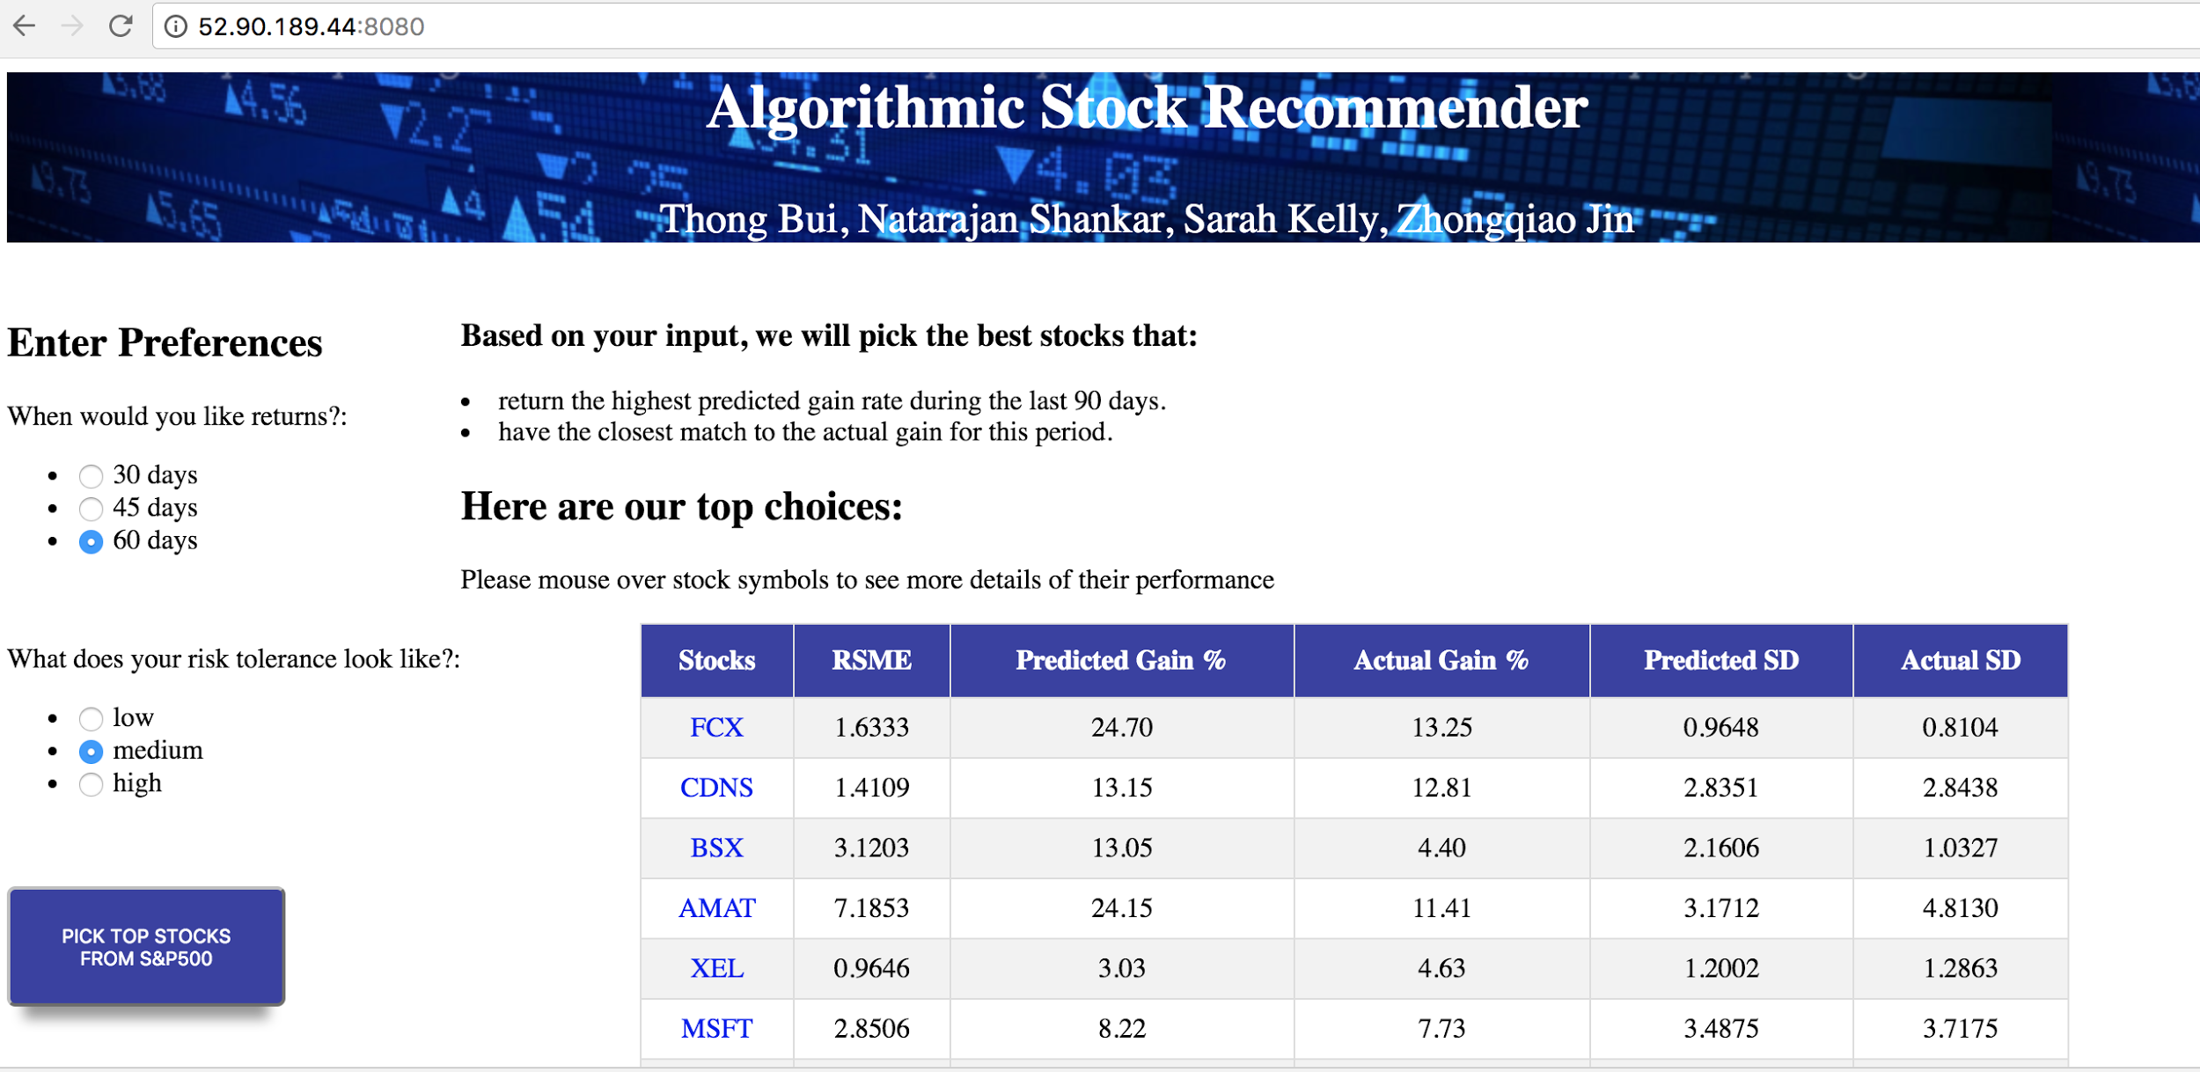
Improved UI
Or
Notes:
Sarah

Slide 13
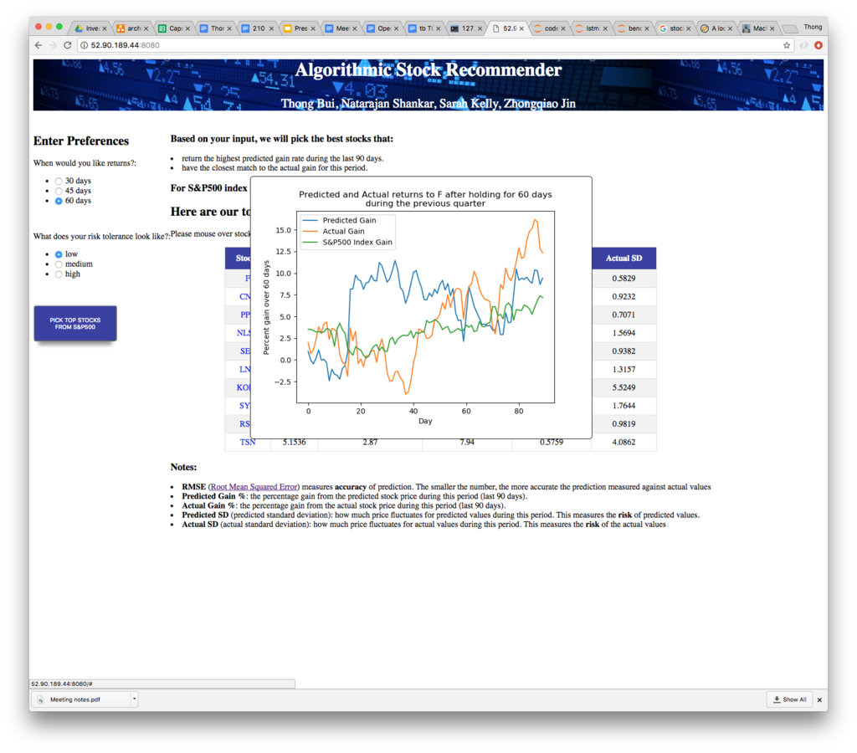
Improved UI
Notes:
Sarah

Slide 14
How we communicate
value
Core question is how do we show our potential users why they should trust us
Limitations:
Technical knowledge of audience
Balancing demonstrating value with not being overly certain
Main tactic: written page describing at a higher level, with details on request
Overview of process in friendly language
Describe model testing/verification
Describe limitations
Core feedback:
Reading model description test, users generally felt that they had a good basic understanding
“I feel like the website isn’t trying to trick me -- you are upfront about the uncertainty”
“Can I use this now?” (I said no)
Notes:
Sarah

Slide 15

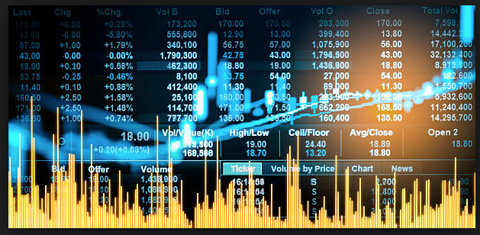
Next steps
Our presented product is a prototype but it is has large potential
It is data driven, incorporates analytical intelligence, presents a simple user interface and is intended to be open for use
Product enhancements for functionality and robustness
Conduct market tests to understand usage patterns and results
Product internals:
Extend the natural language and sentiment interpretation capability
Extend the training data to enhance the predictive capability
Provide more user options
Provide flexible predictive time periods
Notes:
Shankar -
Enhanced architecture:
store data in some DB
Automate daily data data pull, ML data training and push new predictions
Acquire data from paid data service providers
Extend the model over multiple revenue and economic cycles
Model with data from before 2008 stock crash
Tune with different LSTM configurations

Slide 16
Demo
We have webapp ready: http://52.90.189.44:8080/background
Observations: For the last 90 days:
Within the same time period: higher risk yields higher returns
Longer time period yields higher returns
Ex: returns of 60 days > 45 days > 30 days

Slide 17
Thank you!
Q&A
Github: https://github.com/thongnbui/MIDS_capstone
documents: all the documents created for this project
WebApp: flask webapp code
code: all the back-end codes
config: all the config files used
References:
https://machinelearningmastery.com/

